Slide 1
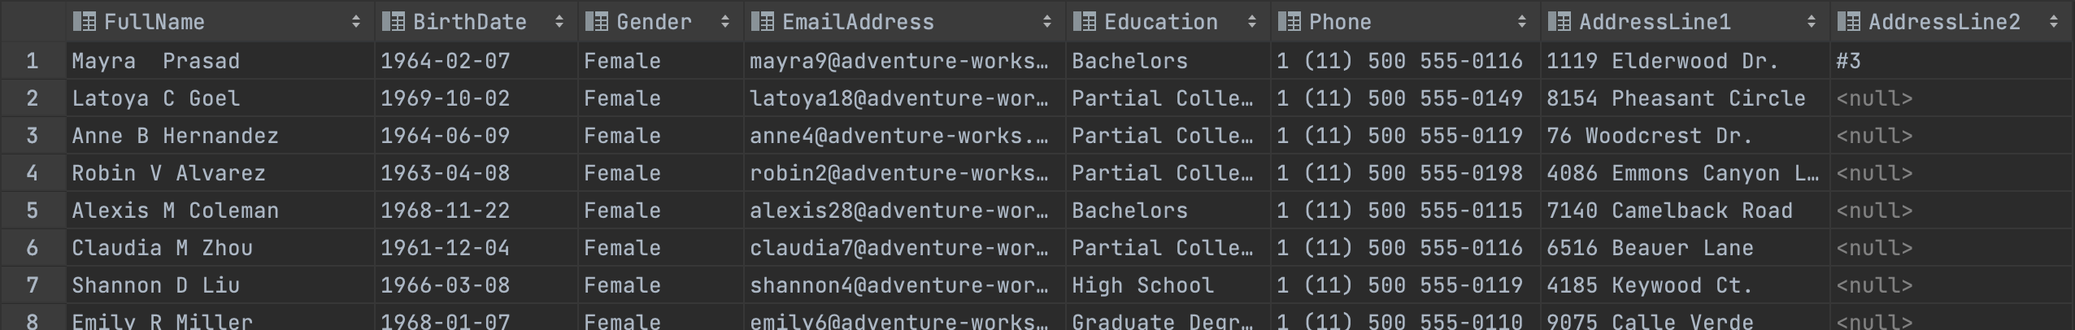
Dimensions Exercise
1. Get information about United Kingdom customers with Country Region Code of GB including columns: FullName, BirthDate, Gender, EmailAddress, Education (English), Phone, AddressLine1, AddressLine2
Note: FullName combines from FirstName, MiddleName, LastName Gender includes F and M, if F shows as Female, M shows as Male
Content: CONCAT(), ALIAS, Trinitarian operator, Join, Where
select Concat(FirstName,' ',MiddleName,' ',LastName) as 'Fullname', BirthDate,
Case when Gender = 'M' then 'Male' when Gender = 'F' then 'Female' end as 'Gender'
,EmailAddress, EnglishEducation as 'Education', Phone, AddressLine1,AddressLine2
from DimCustomer inner join DimGeography on DimCustomer.GeographyKey= DimGeography.GeographyKey where
DimGeography.EnglishCountryRegionName='United Kingdom'
and DimGeography.CountryRegionCode='GB'

Slide 2
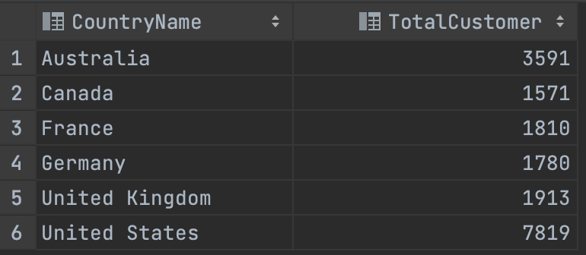
Dimensions Exercise
2. Total number of customers by country includes 2 columns: CountryName, TotalCustomer
Content: Aggregate Function, Group By
SELECT EnglishCountryRegionName, COUNT(*) AS TotalCustomer
FROM DimGeography dg join DimCustomer dc on dg.GeographyKey= dc.GeographyKey
GROUP BY EnglishCountryRegionName;

Slide 3
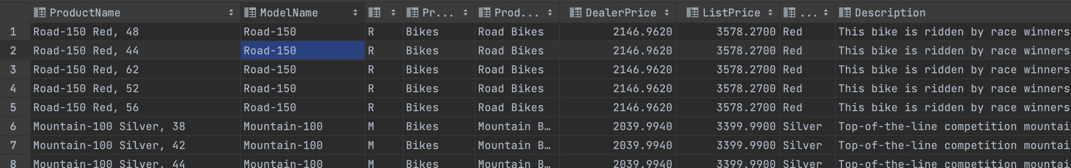
Dimensions Exercise
3. Get the top 100 products of the highest selling price (ListPrice) including the following columns:
ProductName (English), ModelName, ProductLine, ProductCategoryName (English), ProductSubcategoryName (English), DealerPrice, ListPrice, Color, Description (English)
Content: Top, Order By, Join Optimize
select top 100 EnglishProductName as 'ProductName', ModelName, ProductLine,dc.EnglishProductCategoryName as'ProductCategoryName',
dpc.EnglishProductSubcategoryName as 'ProductSubcategoryName',DealerPrice,ListPrice,Color,EnglishDescription as 'Description'
from DimProduct dp,DimProductSubcategory dpc,DimProductCategory dc where dp.ProductSubcategoryKey = dpc.ProductSubcategoryKey and dc.ProductCategoryKey=dpc.ProductCategoryKey
order by ListPrice desc

Slide 4
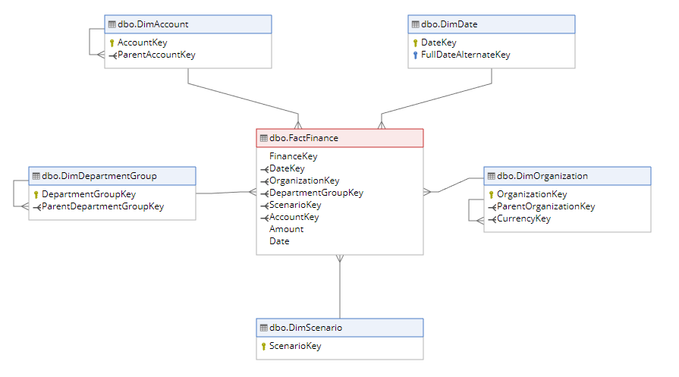
Finance
Finance

Slide 5
Finance Exercise
4. Based on the financial table (FactFinace), calculate the total amount of transactions according to each specific type of accounting compared between the three regions France, Germany, Australia, including the following columns: AccountDescription, France, Germany, Australia
For example, with an account called Accounts Payable, the sum of France is 1498880.17, Germany is 1551664.11, Australia is 716259.95
Note: arrange in A-Z order of AccountDescription
Content: Order By, PIVOT, For, Aggregate Function
select AccountDescription, [France], [Germany], [Australia] from
(
SELECT AccountDescription,do.OrganizationName, SUM(ff.Amount) as Tong
FROM FactFinance ff join DimAccount da on ff.AccountKey=da.AccountKey inner join DimOrganization do on do.OrganizationKey=ff.OrganizationKey
where do.OrganizationName = 'France' or do.OrganizationName = 'Germany' or do.OrganizationName = 'Australia'
GROUP BY AccountDescription,do.OrganizationName
) t
pivot (
Sum(t.Tong) for t.OrganizationName in ([France],[Germany], [Australia])
) b

Slide 6
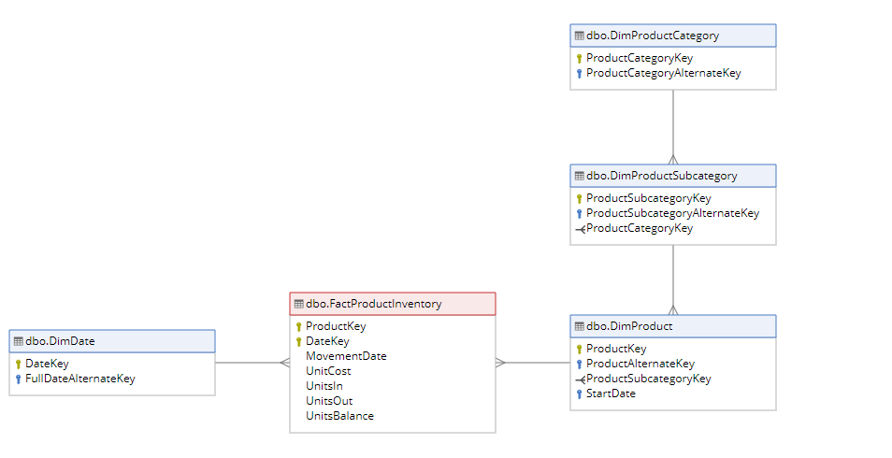
Inventory
Inventory

Slide 7
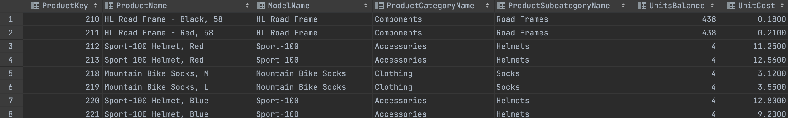
Inventory Exercise
5. Get the latest stock information of all products including the following columns:
ProductKey, ProductName (English), ModelName, ProductCategoryName, ProductSubcategoryName, UnitsBalance, UnitCost
Content: SubQuerys, JOIN condition

Slide 8
with t as(
SELECT ProductKey, MovementDate
FROM (
SELECT ProductKey, MovementDate,
ROW_NUMBER() OVER (PARTITION BY ProductKey ORDER BY MovementDate DESC) AS rn
FROM FactProductInventory
) AS subquery
WHERE rn = 1
)
SELECT
dp.ProductKey,
EnglishProductName,
dc.EnglishProductCategoryName,
ModelName,
EnglishProductSubcategoryName,
fpi.UnitsBalance,
fpi.UnitCost
from t, DimProduct dp
join DimProductSubcategory dpc on dp.ProductSubcategoryKey = dpc.ProductSubcategoryKey
join DimProductCategory dc on dc.ProductCategoryKey=dpc.ProductCategoryKey
inner join FactProductInventory fpi on fpi.ProductKey=dp.ProductKey
where dp.ProductKey= t.ProductKey and fpi.MovementDate=t.MovementDate
group by dp.ProductKey,
EnglishProductName,
dc.EnglishProductCategoryName,
ModelName,
EnglishProductSubcategoryName,
fpi.UnitsBalance,
fpi.UnitCost
order by ProductKey asc

Slide 9
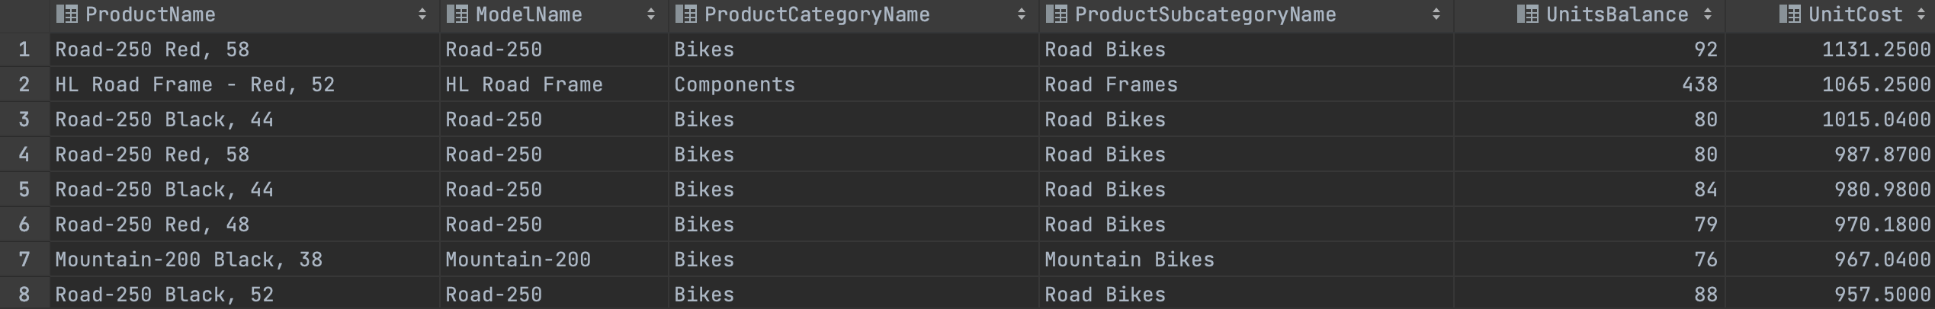
Inventory Exercise
6. Let's get the inventory information of the 10 products with the highest inventory value including the following columns:
ProductName (English), ModelName, ProductCategoryName, ProductSubcategoryName, UnitsBalance, UnitCost
Content: SubQuerys, JOIN condition, Aggregate Function

Slide 10
SELECT
EnglishProductName,
ModelName,
dc.EnglishProductCategoryName as 'ProductCategoryName',
EnglishProductSubcategoryName as 'ProductSubcategoryName',
fpi.UnitsBalance,
fpi.UnitCost
from DimProduct dp
inner join DimProductSubcategory dpc on dp.ProductSubcategoryKey = dpc.ProductSubcategoryKey
inner join DimProductCategory dc on dc.ProductCategoryKey=dpc.ProductCategoryKey
inner join FactProductInventory fpi on fpi.ProductKey=dp.ProductKey
inner join DimDate dd on fpi.DateKey = dd.DateKey
ORDER BY
fpi.DateKey desc,
fpi.UnitCost DESC;

Slide 11
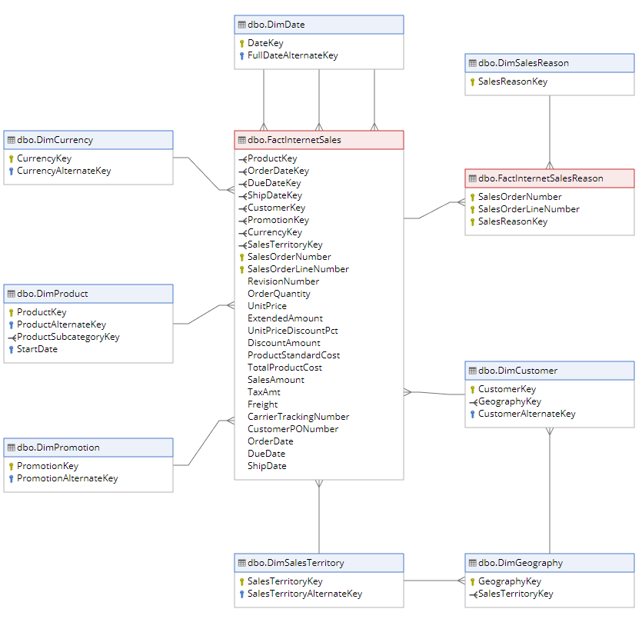
Internet Sales
Internet Sales

Slide 12
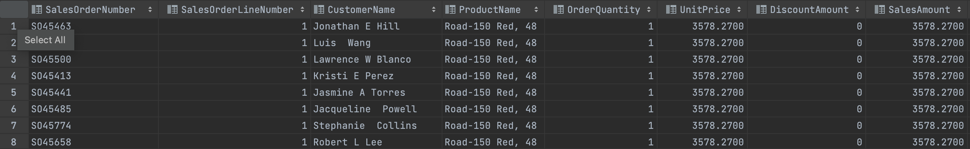
Inventory Exercise
8. Get the Internet Sales invoice details of the product whose English Name is "Road-150 Red, 48" including the following columns:
SalesOrderNumber, SalesOrderLineNumber, CustomerName, ProductName, OrderQuantity, UnitPrice, DiscountAmount, SalesAmount, ProductStandardCost, TotalProductCost

Slide 13
select SalesOrderNumber, SalesOrderLineNumber, CONCAT(FirstName,' ',MiddleName, ' ',LastName) as CustomerName, dp.EnglishProductName as ProductName,
OrderQuantity, UnitPrice, DiscountAmount, SalesAmount, ProductStandardCost,TotalProductCost
from FactInternetSales fis
join DimCustomer dc on fis.CustomerKey = dc.CustomerKey
join DimProduct dp on dp.ProductKey=fis.ProductKey
where dp.EnglishProductName= 'Road-150 Red, 48'

Slide 14
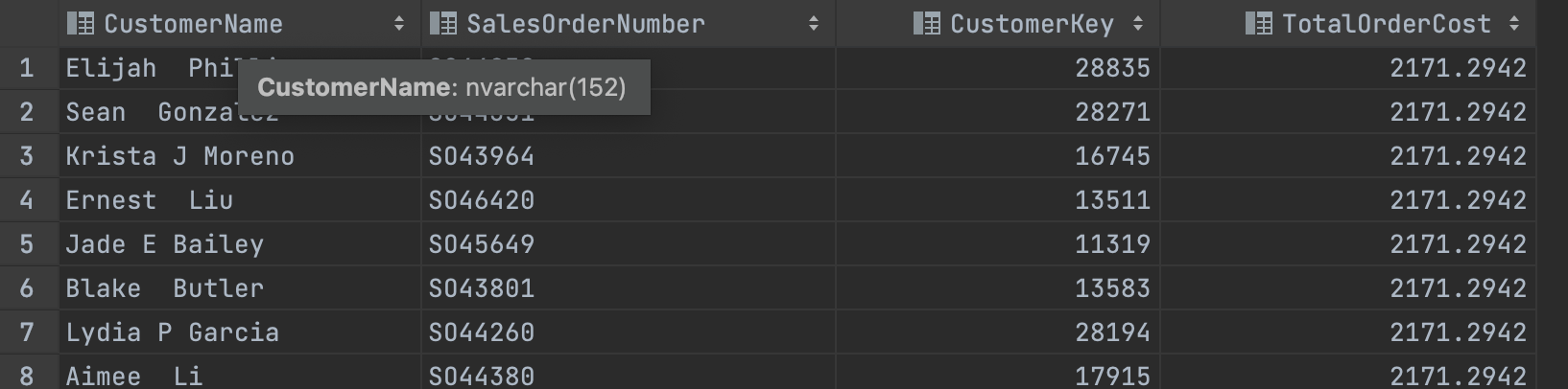
Inventory Exercise
9. Get information 20 Internet Sales invoices with the highest total payable including the following columns: CustomerName, SalesOrderNumber, CustomerKey, TotalOrderCost
Note: SalesOrderNumber has multiple SalesOrderLineNumber

Slide 15
select top 10 CONCAT(FirstName+' ',MiddleName+' ',LastName) as CustomerName,fis.SalesOrderNumber,fis.CustomerKey,SUM(TotalProductCost) as TotalOrderCost
from FactInternetSales fis
inner join DimCustomer dc on fis.CustomerKey = dc.CustomerKey
inner join DimProduct dp on dp.ProductKey=fis.ProductKey
group by FirstName, MiddleName,LastName,SalesOrderNumber,fis.CustomerKey
order by TotalOrderCost desc

Slide 16
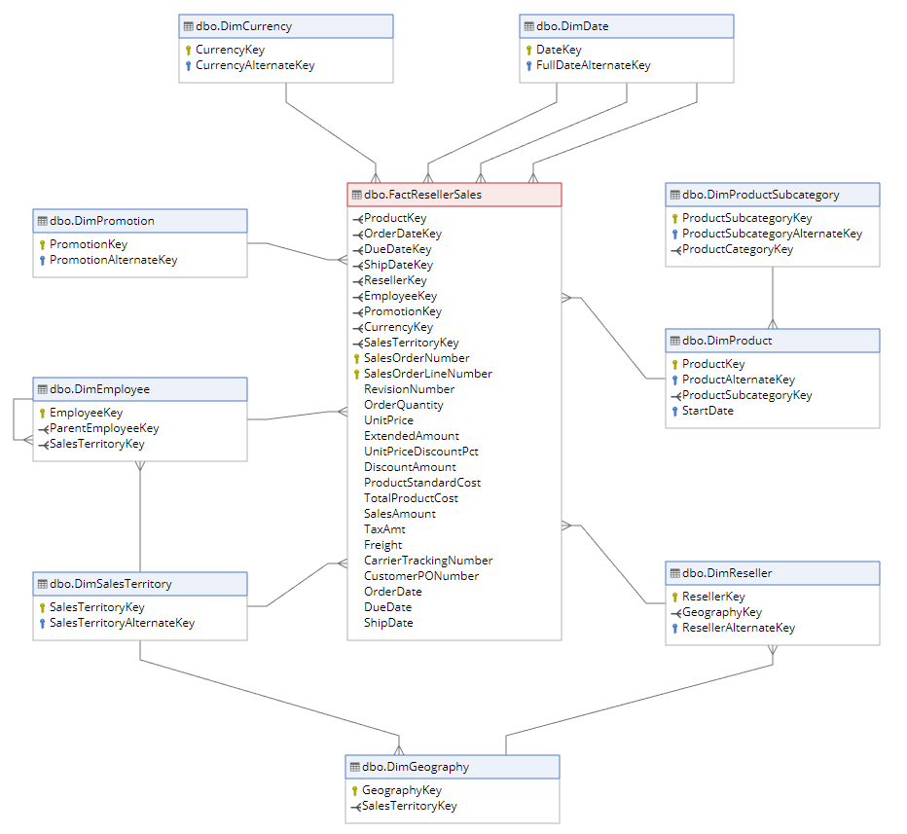
Reseller Sales
Reseller Sales

Slide 17
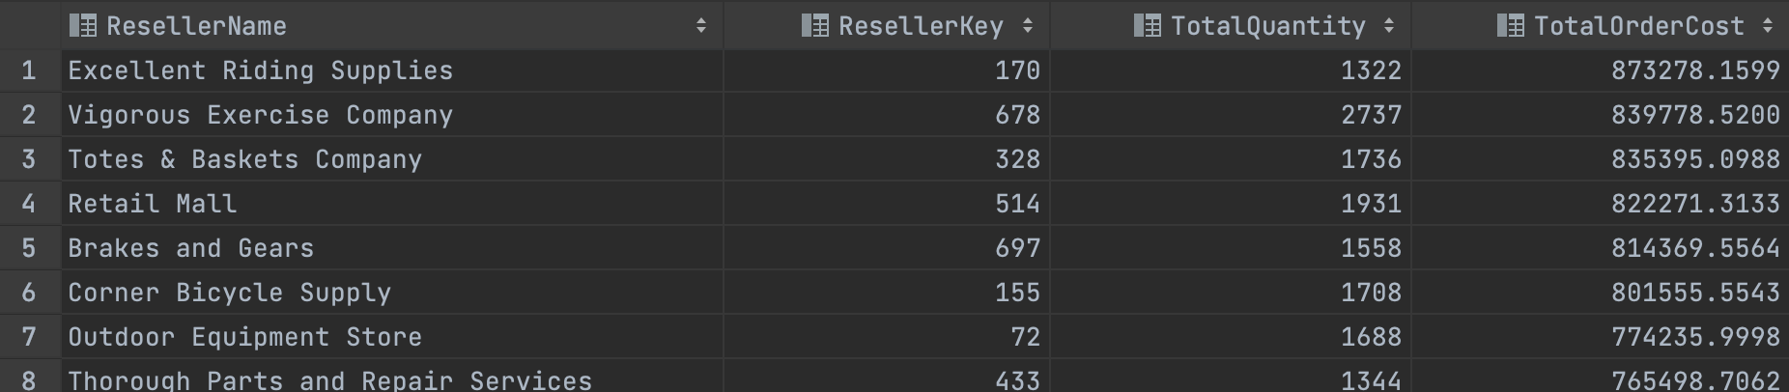
Reseller Sales Exercise
10. Get the top 10 resellers with the highest revenue including the following schools:
ResellerName, ResellerKey, TotalQuantity, TotalOrderCost

Slide 18
with t as(
select top 10 frs.ResellerKey, Sum(frs.TotalProductCost) as TotalOrderCost, Sum(OrderQuantity) as TotalQuantity
from FactResellerSales frs join DimReseller dr on frs.ResellerKey=dr.ResellerKey
group by frs.ResellerKey
order by TotalOrderCost desc
)
select top 10 ResellerName,t.ResellerKey,t.TotalQuantity, t.TotalOrderCost
from t, DimReseller where t.ResellerKey = DimReseller.ResellerKey

